Slide 1



EXPECT TO ACHIEVE
How to apply to University
The following slides outline the process of Applying to University through the UCAS online system.
All the information in this presentation is available on the Woodrush High School FROG page (in the Sixth Form section).
Woodrush High School

Slide 2
EXPECT TO ACHIEVE
The Application Process….
Register with UCAS
Apply online using UCAS
Universities consider application
This is done by logging on to www.ucas.com
Maximum of 5 choices
No offers? UCAS Extra
Make firm/ insurance choice
Conditional or unconditional offers/ rejections
Exam Results
Confirmation
Clearing
Woodrush High School

Slide 3
EXPECT TO ACHIEVE
Key dates for applying
1st September – Opening date
15th October – Deadline for Oxbridge and medicine, dentistry, vet science
15th January – Deadline for all other applicants (also internal deadlines)
______________________________
25th February – UCAS Extra Open
24th March – Some Art and Design courses have an extended deadline
31st March- University deadline to return offers (Not all do)
8th May – You make your firm/insurance choice if received offer before 31st March
30th June – Final Deadline for applications to be sent to universities
Woodrush High School

Slide 4
UCAS – the next few weeks!
Log on to http://www.ucas.com/apply/undergraduate
Don’t forget to apply as part of the school group.
If asked for a buzzword it is woodrush20
Fill out the basic application details – personal information, education details, work history etc
Plan and draft your personal statement. Look at http://www.ucas.com/how-it-all-works/undergraduate/filling-your-application/your-personal-statement
Submit your application online. This then sends it to the school portal for approval. Remember though that before school can send your application, we add a reference, so expect 7 – 10 days from point of submitting before you receive an acknowledgement of receipt and your unique reference number from UCAS
Attend Open Days for the universities you are applying to, so that when you receive your offers you can make an informed choice as to which university to accept as your main preference and which as your insurance or back-up!

Slide 5

EXPECT TO ACHIEVE
One Statement
4,000 characters or 47 lines
What is the personal statement?
‘Your opportunity to tell universities and colleges about your suitability for the course(s) that you hope to study. You need to demonstrate your enthusiasm, passion and commitment for the subject and above all else, ensure that you stand out from the crowd.’
(UCAS, 2013)

Slide 6

The Importance of your personal statement
EXPECT TO ACHIEVE
Your only chance to “speak” to the Academic Tutors
It could distinguish you from other candidates who may have similar grades
They highlight the students who would be interesting to teach
It can provide the information needed for a meaningful interview
A good Personal Statement can make all the difference for borderline cases

Slide 7

What are admission tutors looking for?
EXPECT TO ACHIEVE
Evidence that you have…
Researched the course
Independent study skills
Self-awareness
Motivation and commitment
Good Essay writing skills
Enthusiasm to go beyond the syllabus
A passion for the subject / course
Notes:
This is not an exclusive list and individual institutions will have specific criteria for specific courses

Slide 8

EXPECT TO ACHIEVE
Writing your Personal Statement Where to begin?

Slide 9
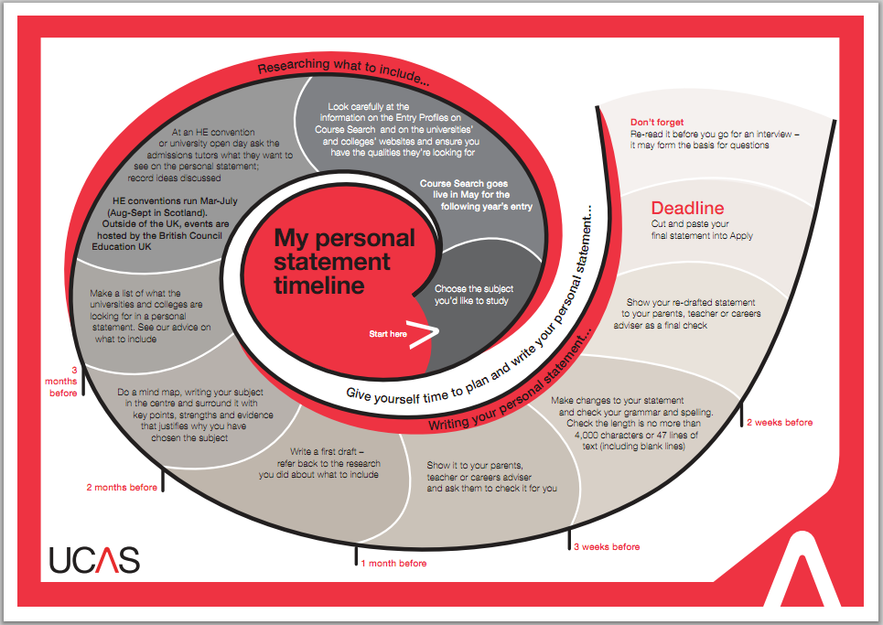
Personal Statement Timeline: Available on FROG
EXPECT TO ACHIEVE
Notes:
This document is in your pack. This slide can be used as an exercise in planning out PS work.

Slide 10
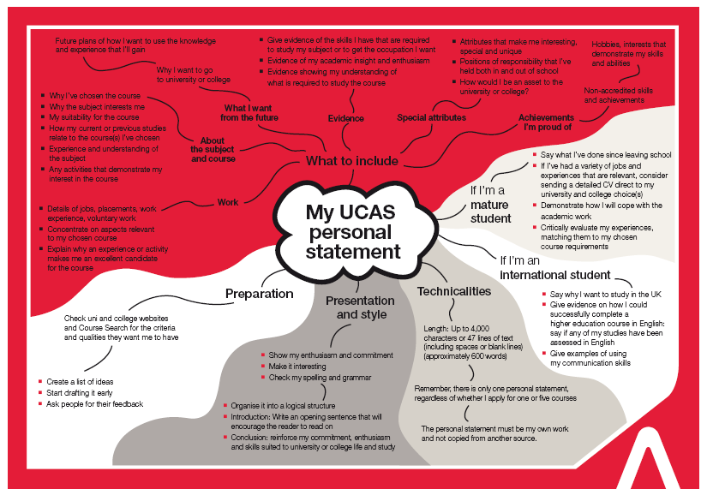
Personal Statement Mind Map: Available on UCAS
EXPECT TO ACHIEVE
Notes:
Hand out copies of this Mind Map and encourage students to choose a section and start writing out some personal information to put into a draft statement.
If there are sections they are struggling on then this can give an indication where additional research needs to be taking place – for example ‘about the course’ or ‘what I want from the future’.

Slide 11

How to structure your Personal Statement
EXPECT TO ACHIEVE
Introduction
The fundamental reasons for wanting to study your chosen course
Why this course out of the 39,000?
Where did your interest in this subject come from?

Slide 12
EXPECT TO ACHIEVE
How to structure your Personal Statement
2/3 Academic Focus
How well have you researched the course? Your understanding of what is expected from you?
What you’re currently studying that relates to the course?
Have you read/researched anything outside of your A Level work that you’ve found fascinating & how does it relate to your course?
What skills do you have/are you developing that would make you a great student to teach?

Slide 13
How to structure your Personal Statement
EXPECT TO ACHIEVE
1/3 Extra Curricular
Think about your work experiences/interests and hobbies and the skills you’ve gained from them.
What are you involved in outside of school that has given you the opportunity to develop new skills?
What life experience has impacted on your decision to study your chosen course?
Have you been employed? How have you coped with balancing your workload?
Gap year?

Slide 14

How to structure your Personal Statement
EXPECT TO ACHIEVE
Conclusion
Try to end it with a positive statement - it could highlight your interest in the course(s) or explain how you think you will benefit from higher education.
However you choose to end your personal statement, it is your final chance to impress and stand out from the crowd

Slide 15

EXPECT TO ACHIEVE
Some Do’s & Don’ts

Slide 16
EXPECT TO ACHIEVE
Do think about what skills or qualities you need to have for the course and how you can demonstrate that you have these
Enthusiasm
Organisational skills
Passionate
Patience
Teacher Training
Adaptable
Team work
Communication skills

Slide 17
EXPECT TO ACHIEVE
Do think about what skills or qualities you need to have for the course and how you can demonstrate that you have these
Leadership Skills
Organisational Skills
Research and data analysis skills
Management & Business
Independence
Effective problem solving skills
Team work
Communication skills

Slide 18
EXPECT TO ACHIEVE
Do Use Key BUZZ WORDS
Criminology Degree
“I want to study Criminology to further develop my understanding about key legislation, the effective management of offenders, the concept of criminal justice and the need to understand issues that relate to crime and criminality.
Studying the behaviour of criminals or investigating their crimes will always be challenging. To help me better understand this field and to gain further experience in it I have worked over the summer months as a volunteer within a local Victim Support charity. I got to work with both current, and ex-offenders, assisting them through the behavioural rehabilitation process.”

Slide 19
EXPECT TO ACHIEVE
Do Use Key BUZZ WORDS
Business Management Degree
“Over the summer I was able to gain work experience as a marketing assistant, working as part of a team to conduct competitor and SWOT analyses as part of a wider market research project.
I have also studied many marketing modules as part of my A-Level course, such as Social Marketing and CRM, something which I believe has further enhanced my understanding of the marketing process. I am proficient with using databases such as Mintel and researching information about the products that the company I work for sold, how their services differed to other companies and the benefits that this had for their customers”.

Slide 20

EXPECT TO ACHIEVE
Don’t Lie
About your work experience
Books you’ve read
Hobbies
Skills

Slide 21

EXPECT TO ACHIEVE
Don’t quote for the sake of quoting!
Philosophy: "I think, therefore I am" – Descartes
Art: "A picture is worth a thousand words" -Napoleon Bonaparte
History: "Those who forget the past are condemned to repeat it" - George Santayana
Maths: "Pure mathematics is the poetry of logic" - Albert Einstein
Teacher Training: “Education, education, education” – Tony Blair

Slide 22
EXPECT TO ACHIEVE
Don’t exaggerate or use silly examples
No X-Factor Auditions Please
“Ever since playing with my dolls as a little girl it has been my life long dream to become a teacher”
It must be true, I saw it on television
“My passion for nursing grew from watching TV shows such as Casualty and Holby City”
“I really want to study Criminology because it is portrayed as such an interesting profession in CSI Miami”

Slide 23
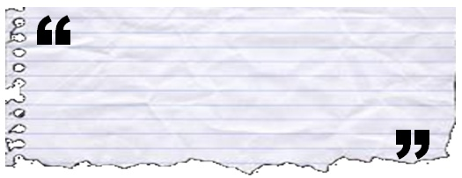
Don’t go over the top…
EXPECT TO ACHIEVE
… and when I’m not working towards World Peace, I enjoy learning languages from scratch, writing symphonies and playing a standard of golf that Tiger Woods can only dream about.
Notes:
Credibility is incredibly easy to loose.

Slide 24
Don’t go over the top…
EXPECT TO ACHIEVE
“They should have a breadth of interests, but that doesn’t mean they have to have climbed Everest single-handed. It doesn’t mean they have to be anything whizz bang. For instance we welcome students who take care of their younger brothers and sisters because their mum works because of what it says about them.”
Richard Taylor, Durham University

Slide 25
EXPECT TO ACHIEVE
Don’t over complicate things...
a) Objective consideration of concrete evidence compelled me to realise the phenomenon was not unprecedented.
b) I realised this often happened.
Notes:
If you don’t check your work you’ll end up feeling like these guys who have just realised they’ve painted the word Shcool instead of School!

Slide 26

Edit, edit, edit!
EXPECT TO ACHIEVE
Notes:
If you don’t check your work you’ll end up feeling like these guys who have just realised they’ve painted the word Shcool instead of School!

Slide 27

Summary: Personal Statement: Do’s & Don’ts
EXPECT TO ACHIEVE
Do’s
Mention future aspirations
Get feedback from others
  Advisers
  Parents / Guardians
Write it early and edit
Take it with you to interview
  Be prepared to answer questions about it
Don'ts
Intellectual pretensions
Misdirected humour
Plagiarism
Mention one institution
Committing GBH on English language
  ‘I so don’t want to miss this opportunity’
  ‘It was a catch 12 situation’
Notes:
Further guidance can be found here: http://www.ucas.ac.uk/students/applying/howtoapply/personalstatement/dos

Slide 28
Interviews
Why do universities interview?
EXPECT TO ACHIEVE
Requirement of external body (e.g. Nursing and Midwifery Council)
More applicants than places
Vocational or practical courses
Quiz your knowledge & skill set
Build on Personal Statement & to find out more about you
Opportunity to find out more about institution and ask questions

Slide 29

Types of interview
EXPECT TO ACHIEVE
One-to-one
Panel (2 or more interviewers)
Presentation
Activity/test (e.g. language/numeracy)
Group interviews

Slide 30

What’s next?
EXPECT TO ACHIEVE
Activity: Start creating your mind maps.
Research, research, research!
Attend open days (www.opendays.com)
Make sure you stand out from the crowd

Slide 31

EXPECT TO ACHIEVE
How to find out more….
Key websites:
www.ucas.co.uk
UCAS Guides: http://www.ucas.ac.uk/students/applying/howtoapply/personalstatement/
The Student Room: http://www.thestudentroom.co.uk/wiki/Personal_Statement_Library

