Slide 1

Woodrush Ready
September 2025
INSPIRE ACHIEVE CELEBRATE

Slide 2
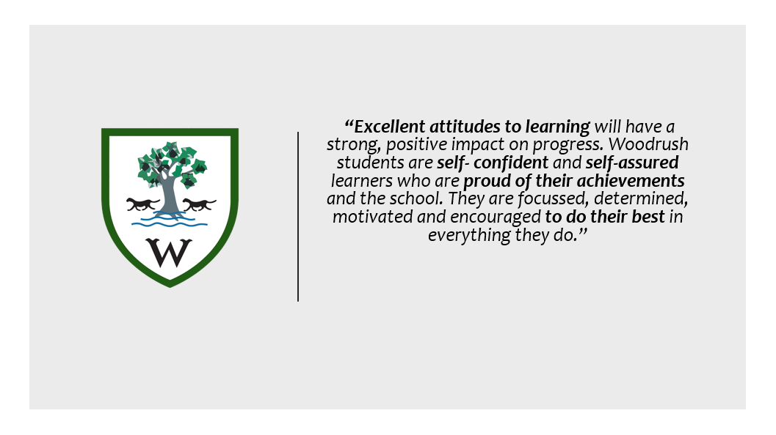
Positive Culture & Ethos at Woodrush
Let your teachers inspire you to dream big, and be brave enough for your dream to become a reality.
To achieve is to meet your full potential. It means to complete all work with excellence and do the very best you can.
We can then celebrate your achievements in school and with parents.
INSPIRE ACHIEVE CELEBRATE

Slide 3
Positive Culture & Ethos at Woodrush
Quality First
Woodrush Ready
Attendance
Uniform & equipment
Punctuality
Conduct Around School
Respectful relationships
Positive Attitude to Learning
To help create and maintain a positive and respectful culture at Woodrush we need all our students to be
Woodrush Ready!
INSPIRE ACHIEVE CELEBRATE

Slide 4

Woodrush Ready
You will learn and practice how to be prepared, productive, respectful and reflective during your form tutorial programme and in assemblies so you are always Woodrush Ready!
INSPIRE ACHIEVE CELEBRATE

Slide 5

Woodrush Ready:
Be Prepared
Be Prepared, Be Productive, Be Respectful, Be Reflective

Slide 6

Attendance to school
Be Prepared
Punctuality to school and lessons:
Students should arrive to school by 8.25am.
Engagement Leads will lock gate at 8.25am and record students who are late.
C1 will be logged every time student is late.
C2 will be logged for any student arriving after 8.45am
C5 truancy will be logged if student arrives after 9.00am (Unauthorised absence AM)
Be Prepared, Be Productive, Be Respectful, Be Reflective

Slide 7

Be Prepared
Daily uniform check:
Blazers and Ties on
Correct footwear – no fluffy socks
Shirts tucked in
No Jewellery except one stud per each ear
No nose/ facial piercings
Make up – no false eye lashes/heavy make-up
No leggings
No hoodies
Coats not to be worn in classroom
We wear our uniform smartly and with pride
Be Prepared, Be Productive, Be Respectful, Be Reflective

Slide 8
Be Prepared
Daily equipment check:
Planner
School bag (Fit A4 folder in)
Pencil case
Pen/Pencils
Green/purple pen
Coloured crayons
Glue stick
Reading book
Calculator
PE kit ( on specific days)
We are organised and ready to learn
Be Prepared, Be Productive, Be Respectful, Be Reflective

Slide 9


Be Prepared
Mobile phones & ear phones should not be seen on school premises.
Students should switch phone off before entering school gate.
Mobile phone will be confiscated if seen by a member of staff and placed in an envelope. (All classrooms/staff on duty will have envelopes available)
Staff will hand envelope into student services.
If confiscated student will be issued with a C2 – HOY detention
Parent or Carer will need to collect them from school that day.
Mobile phones can only be used under the direction of their teacher for educational purposes.
Be Prepared
Be Prepared, Be Productive, Be Respectful, Be Reflective

Slide 10
Woodrush Ready:
Be Productive
Be Prepared, Be Productive, Be Respectful, Be Reflective

Slide 11

How can I be
Woodrush Ready
for lessons?
Be Prepared, Be Productive, Be Respectful, Be Reflective

Slide 12
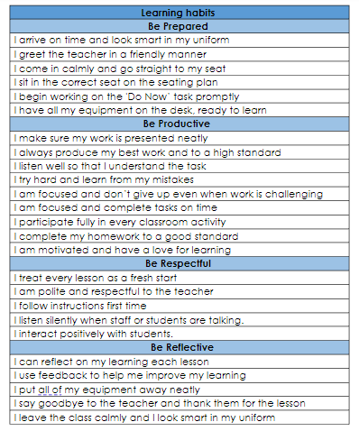

Be Prepared
Be Productive
Be Respectful
Be Reflective
Be Prepared, Be Productive, Be Respectful, Be Reflective

Slide 13


What is Lesson engagement?
“Student engagement refers to the degree of attention, curiosity, interest, optimism, and passion that students show when they are learning or being taught, which extends to the level of motivation they have to learn and progress in their education”.
Be Prepared, Be Productive, Be Respectful, Be Reflective

Slide 14
Be Prepared:
  I arrive on time and look smart in my uniform
  I greet the teacher in a friendly manner
  I come in calmly and go straight to my seat
  I sit in the correct seat on the seating plan
  I have all my equipment on the desk, ready to learn
  I begin working on the 'Do Now’ task promptly
Be Prepared, Be Productive, Be Respectful, Be Reflective

Slide 15
Be Productive:
  I make sure my work is presented neatly
  I always produce my best work and to a high standard
  I use START in all my lessons
  I try hard and learn from my mistakes
  I am focused and don’t give up even when work is challenging
  I complete tasks on time
  I participate fully in every classroom activity
  I complete my homework to a good standard
  I am motivated and have a love for learning
Be Prepared, Be Productive, Be Respectful, Be Reflective

Slide 16



S
Sit up straight and listen
T
Track the teacher
A
Ask and answer appropriately
R
Respect those around you
T
Take responsibility of your learning
Be Prepared, Be Productive, Be Respectful, Be Reflective

Slide 17
Be Respectful
I treat every lesson as a fresh start
I am polite and respectful to the teacher
I follow instructions first time
I listen silently when staff or students are talking.
I interact positively with students.
Be Prepared, Be Productive, Be Respectful, Be Reflective

Slide 18
  Be Reflective
  I can reflect on my learning each lesson
  I use feedback to help me improve my learning
  I put all of my equipment away neatly and stand behind my chair
  I say goodbye to the teacher and thank them for the lesson
  I leave the class calmly and I look smart in my uniform
Be Prepared, Be Productive, Be Respectful, Be Reflective

Slide 19
Class teachers will also use the Woodrush Ready achievement & behaviour to support learning
( please see behaviour & achievement policy for more information)
Be Prepared, Be Productive, Be Respectful, Be Reflective

Slide 20
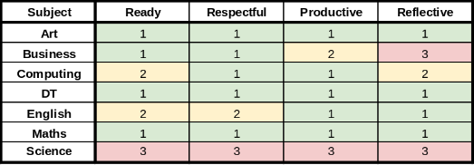
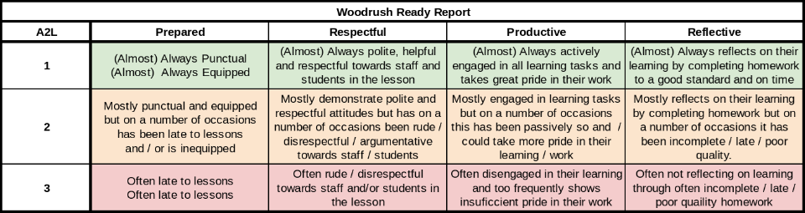
Are you Woodrush Ready?
Twice a year, every student will receive a Woodrush Ready Report.
Teachers will report on how prepared, respectful, productive and reflective students are in lessons.
This will give you a picture of your learning behaviours and how they can improve.
      Class teachers will also use the Woodrush Ready achievement & behaviour to support learning ​( please see behaviour & achievement policy for more information)

Slide 21
Woodrush Ready:
Be Respectful
Be Prepared, Be Productive, Be Respectful, Be Reflective

Slide 22

Be Respectful
All Woodrush students should feel safe from bullying, discrimination and prejudice

Slide 23

Character Development
Autumn 1
Emotional Literacy
Autumn 2
Equality, Diversity & Inclusion
Spring 1
Endeavour
Summer 1
Communication
Summer 2
Empathy
Spring 2
Well-being
Character Development at Woodrush
At Woodrush, we always want you to be in the best frame of mind to focus on your learning. However, life is unpredictable and people are complicated so we will often face challenges.
Working on developing different aspects of our character can make these challenges easier to deal with and overcome.
These are the character skills we will be focusing in Year 7.
INSPIRE ACHIEVE CELEBRATE

Slide 24

Emotional Literacy
Self Assessment
Self Awareness
Self Regulation
Motivation
Social skills
Endeavour
Creating Habits
Challenge
Motivation
Feedback
Setbacks
Resilience
Communication
Listening Skills
Being Sensitive
Non-Verbal
Assertiveness
Problem Solving
Here are the skills we will be looking at in each lesson.
Are there any words you don’t know the meaning of?
Which of these skills do you need to develop most?
Can you think of a time you needed to use any of these skills?
Equality, Diversity & Inclusion
Discrimination and Rights
Becoming Gender Inclusive
Speaking out against sexual harassment
Challenging Homophobia & Transphobia
Disability Inclusion
Anti-Racism
Wellbeing
Nutrition
Exercise
Relaxation
Sleep
Empathy
Reading Widely
Using Film
Stepping out of comfort zones
Global Issues
Local Community
Volunteering

Slide 25
If you have any questions on how to be Woodrush Ready in September, please ask your form tutor on your first day or contact transition@woodrush.org
Thank you for your time
Be Prepared, Be Productive, Be Respectful, Be Reflective

