Slide 1
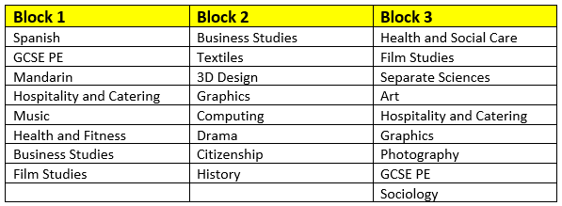
Year 9 Pathways
Welcome to Citizenship Studies

Slide 2

Which subjects do we offer?
Name:
Citizenship Studies GCSE
Exam board:
Edexcel

Slide 3
Which topics do we teach
Theme A: Living together in the UK. Students explore the diverse society of the UK by delving into democratic rights, freedoms and values.
Theme B: Democracy at work in the UK. Students explore the idea of representative, parliamentary democracy in the UK.
Theme C: Law and justice. Students explore why we need laws and how law affects us in our everyday lives.
Theme D: Power and influence. Students examine how individuals, groups, and institutions exert power and influence to shape decisions and actions.
Theme E: Taking citizenship action. Students carry out a planned course of informed action to address a citizenship issue.

Slide 4
What the assessment looks like
 | MODULE(S) | ASSESSMENT | Percentage of overall grade
Paper 1 | Four sections with a focus on themes A-D. This paper will include a separate source booklet. | Written examination: 1 hour 45 minutes 50% of the qualification 80 marks | 50% of total GCSE
Paper 2 | Three sections with a focus on themes A-E. This paper will include a separate source booklet. | Written examination: 1 hour 45 minutes 50% of the qualification 80 marks | 50% of total GCSE

Slide 5
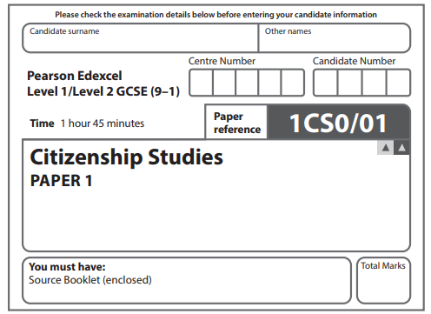
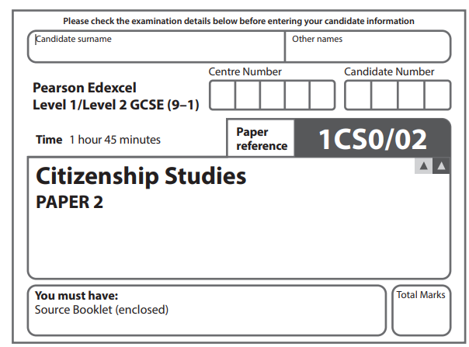
Two papers, externally assessed
1 hour 45 minutes each
Source based questions in both
Mixture of short and long answer questions
Grades range 1-9, currently the average grade 4 in Y10
Two synoptic tests in Year 10
One synoptic test in Year 11
Regular assessments in each topic throughout the years

Slide 6
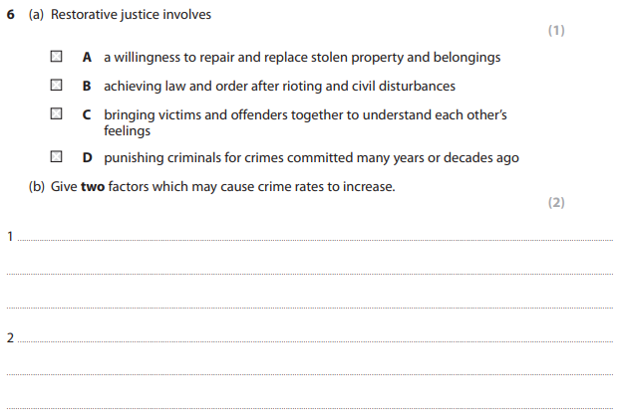
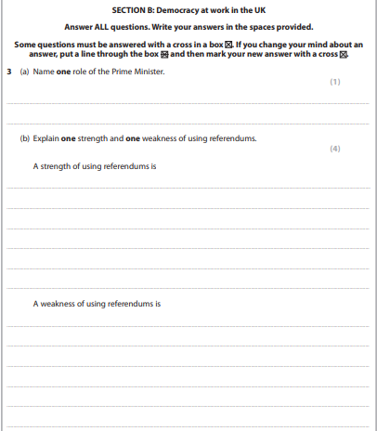
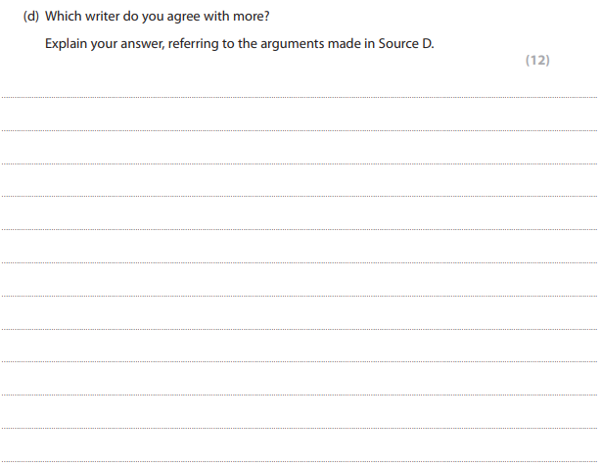

Slide 7

Why choose Citizenship?
Careers
Law, politics, policing, journalism, education, research, civil servant, community worker amongst others
Next steps
Social sciences (health and social care, psychology, sociology, criminology)
Humanities
English
Skills and abilities:
Knowledge of core concepts
Developing critical thinking skills
Engaging with current issues
Taking an active role
Approaching exams with confidence

Slide 8
What do our students say?
It is informative and we get to learn about how the country is governed
We learn how to analyse sources
I am looking forward to the trips
This is a good way to learn more about careers in politics and law

